Slide 1

Istio
A modern service mesh

Slide 2

Present the problems we’re trying to solve
Very brief architectural overview
Status
Service Mesh
???

Slide 3
Elevate the network to the needs of applications
Uniform observability regardless of platform
Security by default, everywhere

Slide 4
try {
HttpResponse response = httpClient.get(
“http://secretsauce.internal/recipe”);
cook(response.body);
} catch (NetworkError ne) {
fixmePleaseOMG(ne);
}
Notes:
This is the code the application developer wants to write.
We have to acknowledge that things will fail on the network - no fallacies here
Want that call to be reliable - nines please
How do we get it there today?

Slide 5
try {
// Load balancing
IP ip = DNS.lookupSRV(“secretsauce.internal”).pickOne();
HttpResponse response = httpClient.open(ip).get(
“http://secretsauce.internal/recipe”);
cook(response.body);
} catch (NetworkError ne) {
fixmePleaseOMG(ne);
}
Notes:
Lets add some load balancing…
Regionality
Healthc checking

Slide 6
for (int i = 0; i < 3; i++) { // Retry
try {
IP ip = DNS.lookupSRV(“secretsauce.internal”).pickOne();
HttpResponse response = httpClient.open(ip).get(
“http://secretsauce.internal/recipe”);
cook(response.body);
} catch (NetworkError ne) {
if (i == 2) fixmePleaseOMG(ne);
else Thread.sleep(random(5) * 1000);
}
}
Notes:
This is the code the application developer wants to write.
We have to acknowledge that things will fail on the network - no fallacies here
Want that call to be reliable - nines please
How do we get it there today?
animations

Slide 7
Secret key = new Secret(new File(“/somewhere/safe/key”);
for (int i = 0; i < 3; i++) {
try {
IP ip = DNS.lookupSRV(“secretsauce.internal”).pickOne();
HttpResponse response = httpClient.open(ip)
.setHeader(“Authorization”, key.toString())
.get(“http://secretsauce.internal/recipe”);
cook(response.body);
} catch (NetworkError ne) {
if (i == 2) fixmePleaseOMG(ne);
else Thread.sleep(random(5) * 1000);
}
}
Notes:
This is the code the application developer wants to write.
We have to acknowledge that things will fail on the network - no fallacies here
Want that call to be reliable - nines please
How do we get it there today?
animations

Slide 8
Secret key = new Secret(new File(“/somewhere/safe/key”);
for (int i = 0; i < 3; i++) {
try {
IP ip = DNS.lookupSRV(“secretsauce.internal”).pickOne();
HttpResponse response = httpClient.open(ip)
.setHeader(“Authorization”, key.toString())
.get(“http://secretsauce.internal/recipe”);
log(“Success”);
cook(response.body);
} catch (NetworkError ne) {
log(“Failed”);
if (i == 2) fixmePleaseOMG(ne);
else Thread.sleep(random(5) * 1000);
}
}
Notes:
Monitoring and logging.
Paucity of information. No
Latency
Indication of number of attempts
Failure modes
Things we didn’t cover
Health checking
Circuit breaking
Alerting
...

Slide 9



Notes:
Point about code bloat and platforms
… so you add all those features to your app
its streamlined, fast, shiny and cool
lets call him
ColdFusion, JRun, Flask, ASP.net, RubyOnRails
Homegrown
now you create one with each new framework
… time passes by

Slide 10
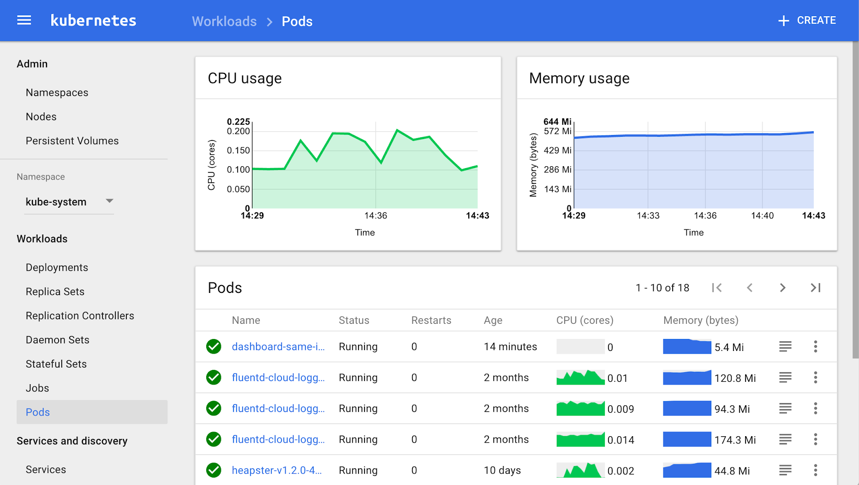
Notes:
This is the default view of monitoring in Kubernetes.
This is useful but not particularly informative
If you click the ‘services’ tab
You get a list of services but no information about their interactions
Hard to use this to manage to SLOs

Slide 11
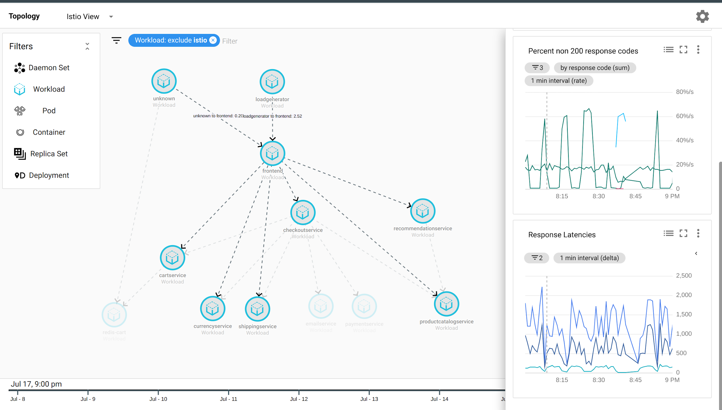
Notes:
This is the default view of monitoring in Kubernetes.
This is useful but not particularly informative
If you click the ‘services’ tab
You get a list of services but no information about their interactions

Slide 12



Istio Architecture
Service A
HTTP/1.1, HTTP/2, gRPC or TCP -- with or without mTLS
Service B
Pilot: Control plane to configure and push service communication policies.
Envoy: Network proxy to intercept communication and apply policies.
Mixer: Policy enforcement with a flexible plugin model for providers for a policy.
Citadel: Service-to-service auth[n,z] using mutual TLS, with built-in identity and credential management.
proxy
proxy
Policy checks, telemetry
Config data to Envoys
TLS certs to Envoys
Pilot
Mixer
Citadel
Control Plane API
Notes:
Sidecar proxies per microservice to handle ingress/egress traffic between services in the cluster and from a service to external services. The proxies form a secure microservice mesh providing a rich set of functions like discovery, rich layer-7 routing, circuit breakers, policy enforcement and telemetry recording/reporting functions.

Slide 13
Resiliency
Istio adds fault tolerance to your application without any changes to code
Resilience features
Timeouts
Retries with timeout budget
Circuit breakers
Health checks
AZ-aware load balancing w/ automatic failover
Control connection pool size and request load
Systematic fault injection
// Circuit breakers
destination: serviceB.example.cluster.local policy: - tags: version: v1 circuitBreaker: simpleCb: maxConnections: 100 httpMaxRequests: 1000 httpMaxRequestsPerConnection: 10 httpConsecutiveErrors: 7 sleepWindow: 15m httpDetectionInterval: 5m
Notes:
In our experience working with a diverse set of clients, 95% of them are happy with an out of process sidecar implementing all the resiliency features such as circuit breakers instead of having to build them into the application code.
Secondly, in most of the cases, there is a fair amount of parameter tweaking - e.g., making sure that timeouts across services are not too tight or ensuring that a circuit doesn’t open too early.
Istio provides dynamically configurable resilience features that you can tweak at runtime, *in production*.

Slide 14
Resiliency Testing
Systematic fault injection to identify weaknesses in failure recovery policies
HTTP/gRPC error codes
Delay injection
Timeout: 100ms
Retries: 3
300ms
Timeout: 200ms
Retries: 2
400ms
Envoy
Envoy
Envoy
svcA
svcB
svcC
Service A
Service B
Service C
Notes:
Systematic resilience testing allows you to test the ability of your services to recover from failures. You can isolate failures to specific subset of requests (such as those coming from QA teams), while running these tests in production.
If you recall the excellent Linkerd talk that Oliver gave this morning, he talked about a scenario where a chain of service calls had incompatible timeouts and retries. Well, you can always recover from these issues by using timeouts/retries/circuit breakers on the very first service in the call chain. But think of all the wasted work in the backend services (resources being held up).
Worse yet, think of the impact on your users. For example, consider Netflix recommendations. When the system is running well, you get personalized recommendations. That is a “feature”. When the personalized recommendations system is down, Netflix falls back to “generic recommendations”. This is great as long as the outage is temporary. But what if this becomes the permanent user experience for weeks at a stretch, because some frontend system had a misconfigured timeout that caused it to prematurely terminate API calls to the recommendation engine.

Slide 15

Traffic Splitting
serviceB.example.cluster.local
// A simple traffic splitting rule
destination: serviceB.example.cluster.local
match: source: serviceA.example.cluster.local route: - tags: version: v1.5
env: us-prod
weight: 99
- tags: version: v2.0-alpha
env: us-staging
weight: 1
Rules API
Pod Labels:
version: v1.5
env: us-prod
Pilot
Traffic routing rules
Envoy
99%
Pod
Envoy
svcB
Service B
http://serviceB.example
1%
svcA
Envoy
Service A
svcB
Traffic control is decoupled from infrastructure scaling
Pod Labels:
version: v2.0-alpha, env:us-staging
Notes:
Traffic control is decoupled from infrastructure scaling - i.e., the proportion of traffic routed to a version is independent of number of instances supporting the version
You can program these traffic routing rules using istio on the fly using simple rules as shown in the slide. These rules get translated into low level Envoy configs. Envoy periodically fetches configs from the manager and updates its internal routing table. There are no hot restarts, no impact to existing traffic.
We call this tag based routing.

Slide 16
Traffic Steering
Service B
version: v1
Pod 1
// Content-based traffic steering rule
destination: serviceB.example.cluster.local match: httpHeaders: user-agent: regex: ^(.*?;)?(iPhone)(;.*)?$ precedence: 2 route: - tags: version: canary
Pod 2
svcA
Pod 3
svcB
Service A
Service B
version: v1
Pod 1
User-agent: *Android*
Pod 2
Pod 3
svcA
svcB
Service A
User-agent: *iPhone*
Content-based traffic steering
Pod 4
svcB’
version: canary
Notes:
Content-based traffic steering - The content of a request can be used to determine the destination of a request
Another way to route requests is the age old method. Look at the contents of a request and route it to a specific set of instances. This opens up all sorts of possibilities. For a user facing service, you could route a portion of mobile traffic from a particular device, say an iPhone, to a specific version of the service. For internal services, callers would have the ability to explicitly request a particular version of the service. In fact, Verizon is using this particular technique in production today.

Slide 17
“What’s the life of a request?”

Slide 18
Service A
Service B
Service A comes up. Envoy is deployed with it and fetches service information, routing and configuration policy from Pilot. If Citadel is being used, TLS certs are securely distributed as well.
proxy
proxy
Routing and load balancing config to Envoys
TLS certs to Envoys
Pilot
Mixer
Citadel
Life of a request in the mesh

Slide 19
Service A
Service B
Service A places a call to service B.
Client-side Envoy intercepts the call.
Envoy consults config to know how/where to route call to service B (including any dynamic routing rules).
proxy
proxy
Pilot
Mixer
Citadel
Life of a request in the mesh

Slide 20
Service A
HTTP/1.1, HTTP/2, gRPC or TCP -- with or without mTLS
Service B
Envoy forwards request to appropriate instance of service B. There, the Envoy proxy deployed with the service intercepts the call.
proxy
proxy
Pilot
Mixer
Citadel
Life of a request in the mesh

Slide 21
Service A
Service B
Server-side Envoy checks with Mixer to validate that call should be allowed (ACL check, quota check, etc).
proxy
proxy
Policy checks, telemetry
Pilot
Mixer
Citadel
Life of a request in the mesh

Slide 22
Service A
Service B
Server-side Envoy forwards request to service B, which process request and returns response
proxy
proxy
Pilot
Mixer
Citadel
Life of a request in the mesh

Slide 23
Service A
Service B
Envoy forwards response to the original caller, where response is intercepted by Envoy on the caller side.
proxy
proxy
Pilot
Mixer
Citadel
Life of a request in the mesh

Slide 24
Service A
Service B
Envoy reports telemetry to Mixer (latency, response code, url, etc.)
proxy
proxy
Pilot
Mixer
Citadel
Logging adapter
Monitoring adapter
Life of a request in the mesh

Slide 25
Service A
Service B
Client-side Envoy forwards response to original caller.
proxy
proxy
Pilot
Mixer
Citadel
Life of a request in the mesh

